Slide 1

PROJECT 2- NLP AND VADER SENTIMENT ANALYSIS For DIGITAL CURRENCY
Presented by; @Phil, @Acash, @Filip, @tyler (Group 4)

Slide 2
Recap of Project 1
Created a user-friendly Crypto(&NFT) currency dashboard, that allowed users to make investment decisions by predicting the performance of the underlying asset classes over time
The dashboard consisted of historical and real time data, complete with relevant line charts, bar charts and other illustrations

Slide 3
Objectives
Introduce a machine learning model that can analyze and interpret sentiment of tweets that make mention of Crypto currencies to compliment the previously created digital currency comparative/analytical tool.

Slide 4
Scope & Limitations
Twitter API access - only having essential access to Twitter API seemed to limit the data that could be pulled. To mitigate the aforementioned API data was sourced via Kaggle, which did have pre-pulled twitter API data for each of the respective digital currencies we ran the SA model on.
Streamlit deployment and incorporation of model to project 1 output.

Slide 5
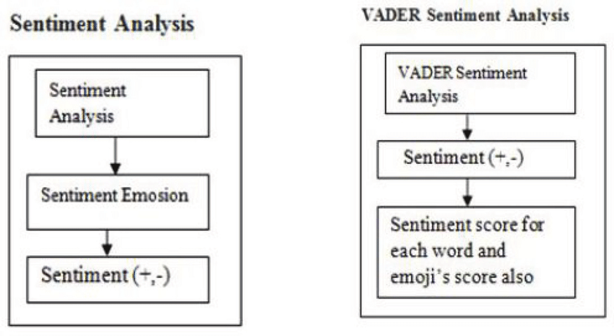
Steps for cleaning data

Slide 6
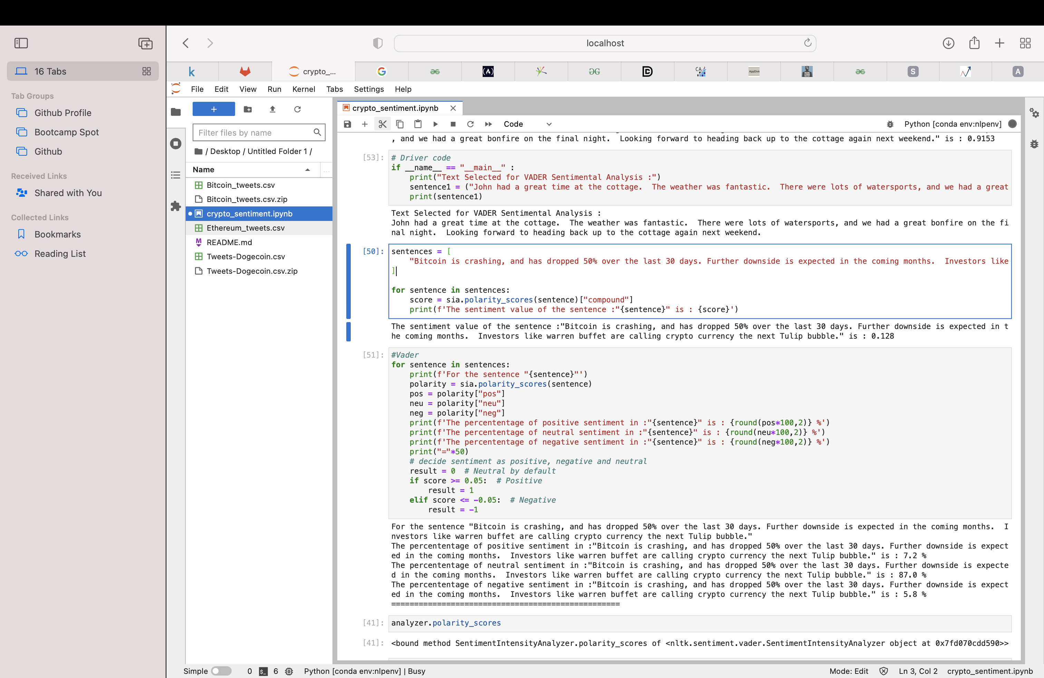
Code Sample1

Slide 7
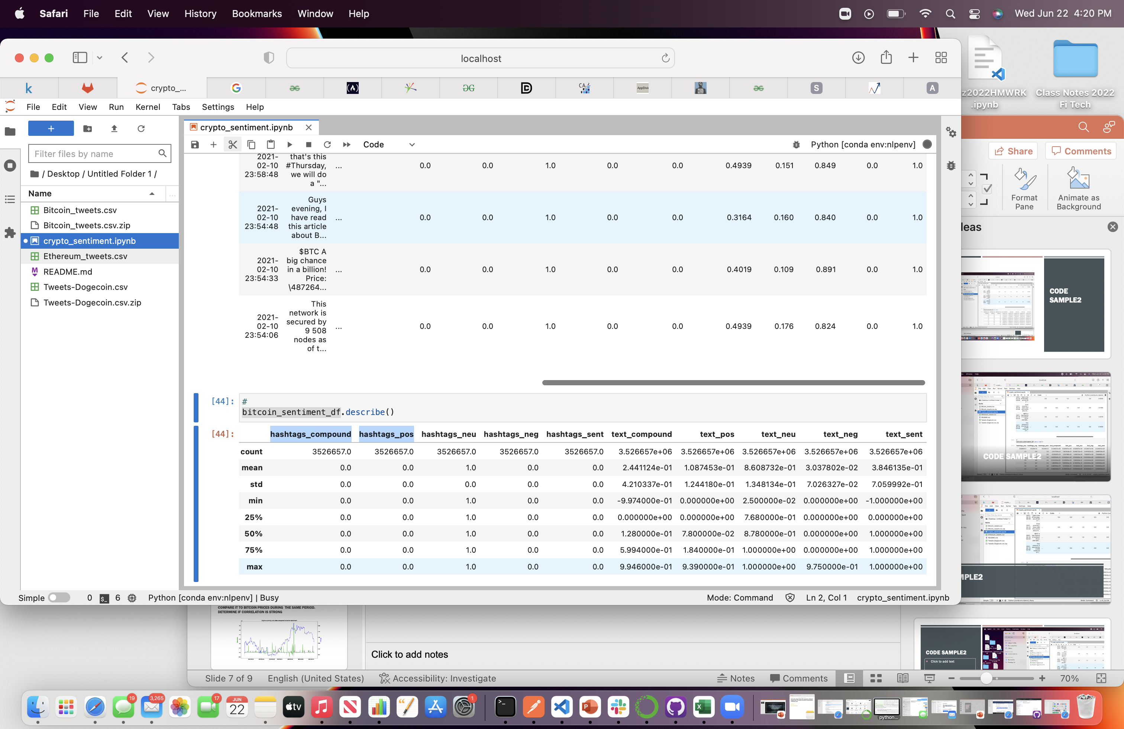
Code Sample2

Slide 8
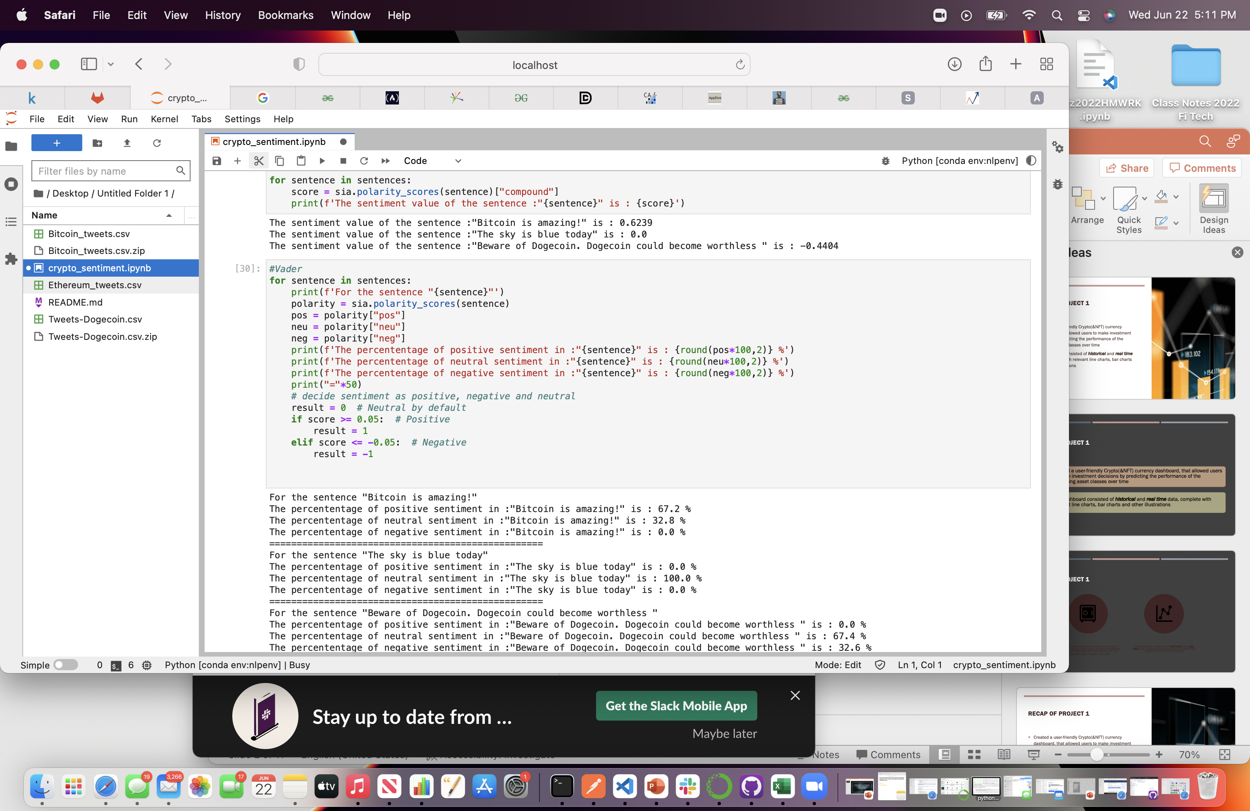
Code Sample3

Slide 9

Conclusions/Next Steps
Expand to include/analyze additional crypto-currencies
Deploy complimentary Vader sentiment analysis model on Streamlit.
Expand Model to include digital currency price fluctuations based on market sentiment, and social media messaging platforms like Twitter.

Slide 10
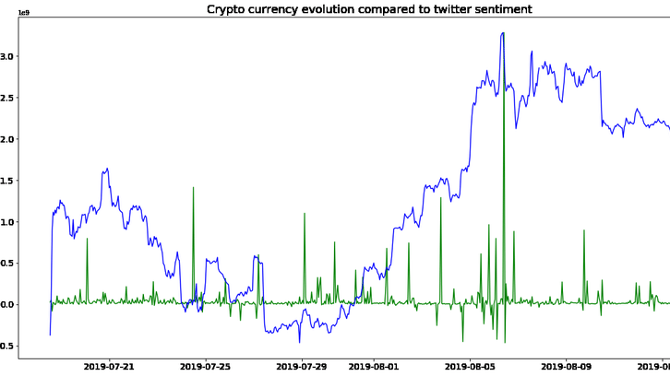
Create a sentiment analysis That can Determine/provide a numerical Correlation between a Tweet and the price of a given crypto Currency.

Slide 11
Thank you for Your Time.
Questions?

